Slide 1
CSI 2372: Advanced Programming Concepts with C++
Amir Afrasiabi Rad
Fall 2012

Slide 2
C++: Object Orientation without classes!
C++ was conceived as an object-oriented extension to C
C was (is) purely procedural language
Functions (methods) are separate from data
Complex data structures exist that are not objects
Entire programs can be written using only non-member functions, or (almost) only classes, or (most commonly) some mixture
Therefore C++ is not fully object-oriented

Slide 3
Structure of C++ program
Basic unit is function, not class
Most programs made up of multiple functions
A main function is required in order for a source code file to be a program
One main function must exist
No more than one can exist in the same program

Slide 4
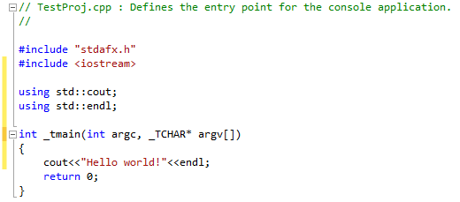
C++: First Project!

Slide 5
Notes on example
Entire program contained in main function – no enclosing class
Function heading for main:
Return type is typically int, not void
No other modifiers (e.g. public, static) as opposed to Java
public static void main(String[] args)

Slide 6
Java and C++
Java
C++
Compiled to byte code
Executed by virtual machine
Object-oriented
Platform-independent byte code
Preprocessor
Compiled to object code
Linked to binary executable
Object-oriented, generic and functional features
Object code and executable are platform-specific

Slide 7
C++ preprocessor
A preprocessor is a program that processes its input data to produce output that is used as input to another program.
C++ preprocessor performs simple substitution of character sequences beginning with '#' for other character sequences
Some substitutes are predefined for preprocessors (e.g. #pragma once)
Some others are defined by the developer or libraries (e.g. file names following the #include directive)

Slide 8
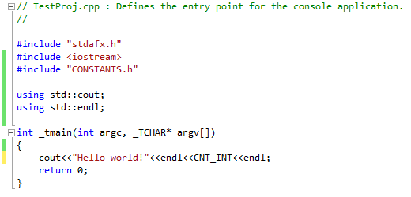
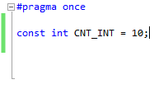
The #include directive
It tells the preprocessor to treat the contents of a specified file as if those contents had appeared in the source program at the point where the directive appears
TestProj.cpp
CONSTANTS.h

Slide 9
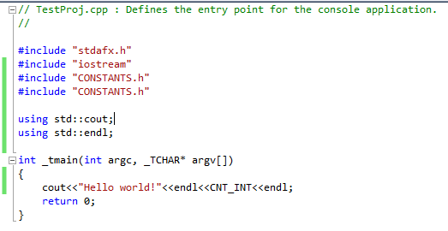
#pragma once directive
TestProj.cpp
CONSTANTS.h
error C2370: 'CNT_INT' : redefinition; different storage class

Slide 10
#pragma once directive
TestProj.cpp
CONSTANTS.h
Preprocessor ignores the second inclusion of “CONSTANTS.h”
Make sure that you include #pragma once directive in all your header files

Slide 11
<iostream> vs. “iostream”
Both syntax forms cause replacement of that directive by the entire contents of the specified include file.
The difference between the two forms is the order in which the preprocessor searches for header files when the path is incompletely specified.
<> format: instructs the preprocessor to search for include files first along the path specified by the compiler, or the path specified by the INCLUDE environment variable
“” format: instructs the preprocessor to look for include files in the same directory of the file that contains the #include statement, and then in the directories of any files that include (#include) that file. The preprocessor then searches along the path specified by the compiler, then paths specified by the INCLUDE environment variable.

Slide 12
<iostream>
<< is a binary operator
<< is called the output or insertion operator
<< is left associative
EXPRESSION HAS VALUE
cout << age cout
STATEMENT
cout << “You are ” << age << “ years old\n” ;

Slide 13
Manipulators
Manipulators are expressions that affect the state of an output stream
endl, fixed, showpoint, setw, and setprecision are manipulators that can be used to control output format
endl is use to terminate the current output line, and create blank lines in output – same effect as the ‘\n’ character

Slide 14
Using Manipulators fixed and showpoint
Use the following statement to specify that (for output sent to the cout stream) decimal format (not scientific notation) be used
cout.setf(ios::fixed);
Use the statement below to specify that a decimal point be included (even for floating values with 0 as fractional part)
cout.setf(ios::showpoint);
Together, these two statements ensure that output of floating-point numbers will be uniform for the duration of the program (or until the settings are changed by a subsequent statement or statements)

Slide 15
setprecision(n)
requires #include <iomanip.h> and appears in an expression using insertion operator (<<)
if fixed has already been specified, argument n determines the number of places displayed after the decimal point for floating point values
remains in effect until explicitly changed by another call to setprecision

Slide 16
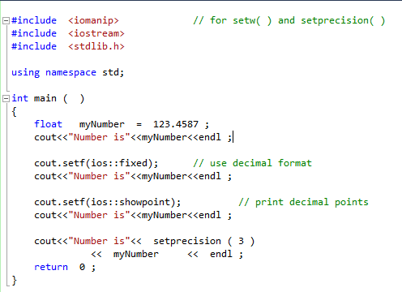
What is exact output?

Slide 17
Manipulator setw
“set width” lets us control how many character positions the next data item should occupy when it is output
setw is only for formatting numbers and strings, not char type data

Slide 18
setw(n)
requires #include <iomanip> and appears in an expression using insertion operator (<<)
argument n is called the fieldwidth specification, and determines the number of character positions in which to display a right-justified number or string (not char data). The number of positions used is expanded if n is too narrow
“set width” affects only the very next item displayed, and is useful to align columns of output

Slide 19
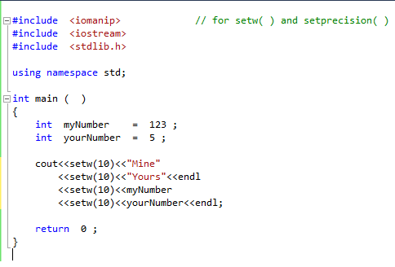
What is exact output?

Slide 20
Keyboard input
Object cin represents the input stream
The extraction operator takes data from the stream and puts it in a variable:
int x; // variable declaration
cout << “Enter a number: ”; // prompt
cin >> x; // read
cout << “You entered: ” << x << endl; // echo
Although input can be chained, this is not advisable with interactive programming

Slide 21
Keyboard input
General syntax:
cin >> variable;
The only thing that can go on the right of the extraction operator is a variable – stores data extracted from the input stream

Slide 22
Extraction and white space
The >> operator reads, but does not store as data, any leading white space characters
White space characters include:
Spaces
Tabs
Newline characters
To the extraction operator, such characters are delimiters – they define where one data item ends and the next one begins
This means space characters aren’t considered data by the extraction operator, even if the data type of the destination variable is char

Slide 23
Example
NOTE: shows the location of the file reading marker
STATEMENTS CONTENTS MARKER
POSITION
int i ; 25 A\n
char ch ; 16.9\n
float x ;
cin >> i ; 25 A\n
16.9\n
cin >> ch ; 25 A\n
16.9\n
cin >> x ; 25 A\n
16.9\n
i
ch
x
25
i
ch
x
25
‘A’
i
ch
x
25
‘A’
16.9
i
ch
x

Slide 24
Example
char first,
middle,
last;
cin >> first;
cin >> middle;
cin >> last;
Suppose the user types:
ABC
What is stored in the variables?
first = ‘A’
middle = ‘B’
last = ‘C’
What if the user types:
A B C
first = ‘A’
middle = ‘B’
last = ‘C’

Slide 25
Example
int age;
char initial;
double bill;
cin >> age;
cin >> initial;
cin >> bill;
What is stored in the variables if the user types:
25 J 2
What if the user types:
2 25 J
What about:
J 25 2

Slide 26
Weakness of extraction
The extraction operator works fine as long as a program’s user provides the right kind of data – a number when asked for a number, for example
If erroneous data is entered (a letter instead of a number, for example), the extraction operator isn’t equipped to handle it; instead of reading the data, it shuts down the input stream, and no more data can be read from it
How can we mitigate this???

Slide 27
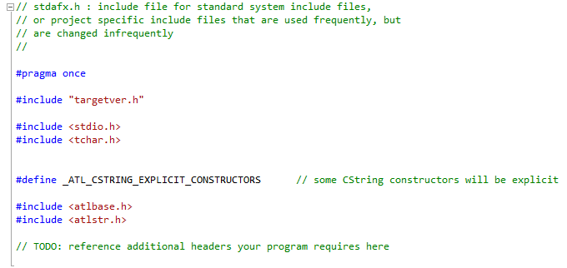
Stdafx.h
TestProj.cpp
Stdafx.h

Slide 28
Stdafx.h
stdafx.h is a file, generated by Microsoft Visual Studio IDE wizards, that describes both standard system and project specific include files that are used frequently but hardly ever change.
Compatible compilers will precompile this file to reduce overall compile times.
Visual C++ will not compile anything before the #include "stdafx.h" in the source file, unless the compile option /Yu'stdafx.h' is unchecked
It only exists in Microsoft-based compilers such as Visual Studio

Slide 29
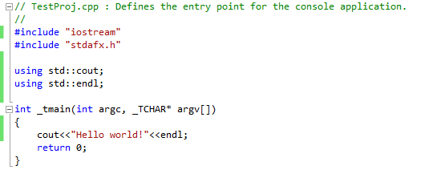
What does this program do?
Actually, it does nothing.
This program generates a compile time error
The compiler never sees #include “iostream” as it is located before #include “stdafx.h”

Slide 30
return 0;
The return statement causes the main function to finish.
return may be followed by a return code (main function can have void return type).
A return code of 0 for the main function is generally interpreted as the program worked as expected without any errors during its execution.
Any value other than 0 represents an error in the program run (program still executes and performs as normal)

Slide 31
Java data types and their C++ counterparts
Java
C++
byte (signed, 8 bits)
short (signed, 16 bits)
int (signed, 32 bits)
long (signed, 64 bits)
boolean (true/false)
char (16 bits, Unicode)
float (32 bits)
double (64 bits)
void
String
char (sort of)
int, short
long, int
long
bool
char (sort of - 8 bit ASCII)
float
double
void
string

Slide 32
Notes on C++ data types
Language specification doesn’t specify actual sizes, only relative sizes, as follows:
short <= int <= long
float <=double
Typically, char is 8-bit; uses ASCII, not Unicode
Numbers can be designated “unsigned”
all positive
doubles magnitude of maximum value

Slide 33
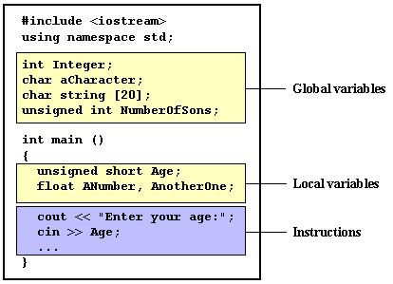
Variables and Scope
Anything that is defined by a Type in C++ is a variable
There are two major forms of variables:
Global: can be referred from anywhere in the code, even inside functions, whenever it is after its declaration (limited to the file that they are defined in, unless included in a different file)
Local: the scope of local variables is limited to the block enclosed in braces ({}) where they are declared
Class: a name of a class element is local to the class, i.e., can only be accessed inside the class or must be used together with . -> or ::

Slide 34
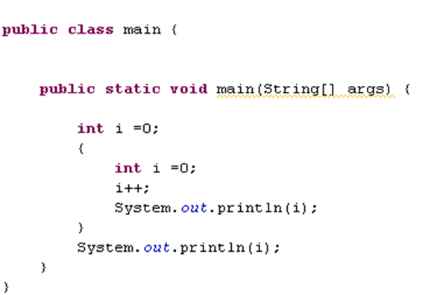
Scope of variables
Java
C++
Error: Duplicate local variable i
In C++ variables can override they outer scope
A variable CANNOT be defined more than once in the same scope

Slide 35
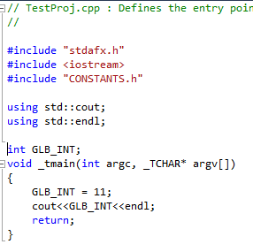
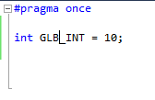
The “extern” keyword
What is the output of this program?
TestProj.cpp
CONSTANTS.h
error C2086: 'int GLB_INT' : redefinition

Slide 36
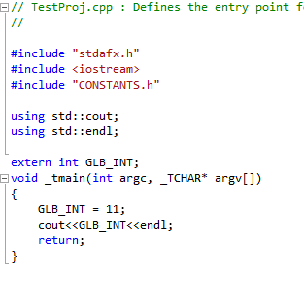
The “extern” keyword
if you declare an extern variable in a source file and that variable already exists in the header file, the variable you are now using in the source file is actually the one you declared in the header file
TestProj.cpp
CONSTANTS.h

Slide 37
C++ is NOT strongly typed
Can do assignment without cast (but not without consequence)
Example:
double d = 3.9999;
int x = d; //demotion
// x is assigned 3 – value is truncated, not rounded, so you lose data
//Java creates a compile time error for demotion
demotion is when you try to store data from a larger (capable of fitting more data) data type into a smaller data type

Slide 38
Constants in C++
Literals and Numbers: are the most obvious kind of constants (e.g. 5, 75.43, “Hello”, …)
Literal constants, like variables, are considered to have a specific data type. By default, integer literals are of type int. However, we can force them to either be unsigned by appending the u character to it, or long by appending l:
75 // int
75u // unsigned int
75l // long
75ul // unsigned long

Slide 39
Constants in C++
The default type for floating point literals is double. If you explicitly want to express a float or a long double numerical literal, you can use the f or l suffixes respectively: 3.14159L // long double
6.02e23f // float
Character and string literals: There also exist non-numerical constants, like:
'z‘ //character (char)
"Hello world” //String

Slide 40
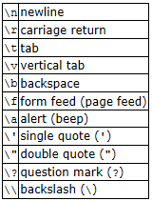
Constants in C++
Character and string literals have certain peculiarities, like the escape codes (/). The following table represents the built in escaped strings:
Examples:
‘\n’ //equal to endl
‘\t’
"Left \t Right"
"one\ntwo\nthree"

Slide 41
Defined constants (#define)
You can define your own names for constants using #define directive
The format for define is:
#define identifier value
e.g.
#define PI 3.14159
#define NEWLINE '\n'
How is #define different from const?
#define does not consume memory. It is a directive that is processes by preprocessor and literally replaces every occurrences of the variable with its definition

Slide 42
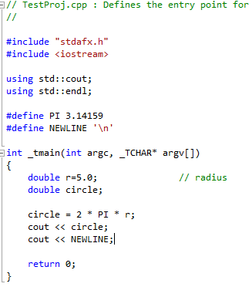
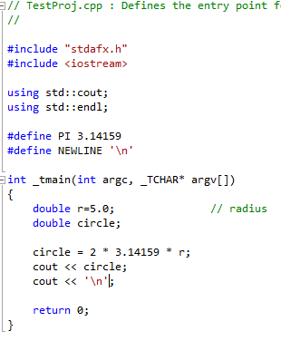
#define directive
What preprocessor sees
What compiler sees

